Slide 1
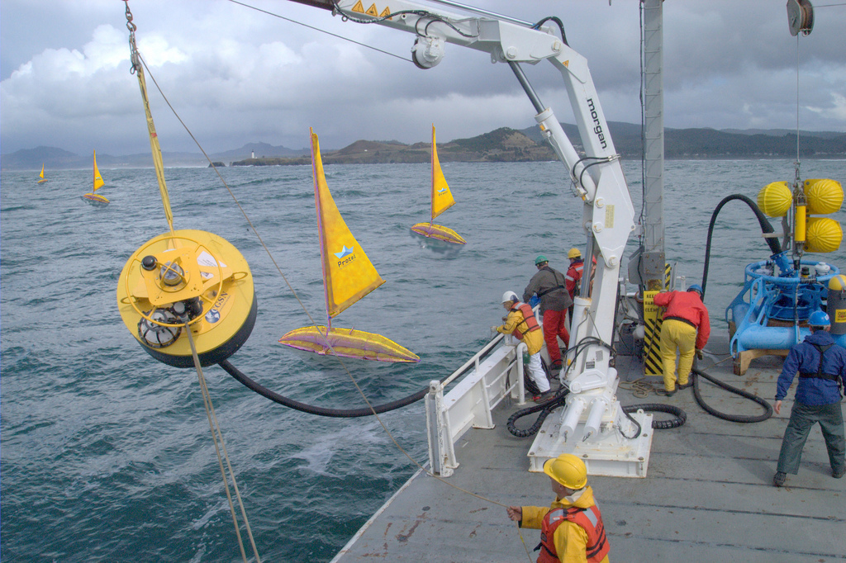
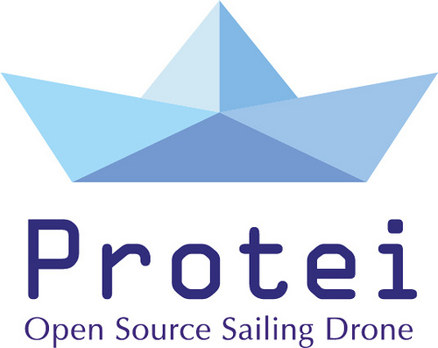
Protei “OPEN SOURCE, SHAPE SHIFTING SAILING ROBOTS, TO EXPLORE AND PROTECT THE OCEANS.”
Sponsorship Proposal
July 2012
contact@protei.org

Slide 2
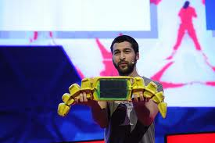
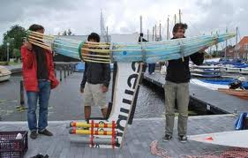
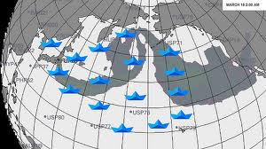
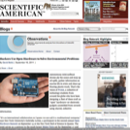
What is Protei?
Originally developed to clean up the BP oil spill in the Gulf of Mexico, Protei has many applications, from transporting scientific payload, oil spill cleanup, and radioactivity sensing, to studying coral reefs, monitoring fisheries, and much more.
Wired.com, Tim Maly
“Someday, this fish boat robot-thing could be surveilling the oceans.”

Slide 3
Newsworthy Ocean Technology
We are developing a sailing robot to study and clean the oceans
that is creating waves in global media.
Scientific American, David Biello
“Hackers Use Open Hardware to Solve Environmental Problems. Open hardware is not just about making fetishes; it’s also about saving the world.”
CNN, Sean Yeaton “Protei is unmanned, autonomous, relatively inexpensive and open hardware (anybody can use, modify and distribute its designs), making it a potentially powerful weapon in the battle to clean up the Gulf of Mexico while preserving the safety of the workers who would otherwise be exposed to the toxic mess. Already Harada imagines other uses for the sailboat drone, like oceanography and surveillance.”
The Guardian, Damian Carrington “For big problems, you need big ideas, even if they seem crazily ambitious. And with the anniversary of the BP Deepwater Horizon oil spill on 20 April, a swarm of robot oil-slick clearing boats is a timely big idea. So, Protei seems to me to be useful, simple and backed by smart people. Crucially, by virtue of being open source, the profit motive can't compromise the search for the best technical solution.”

Slide 4
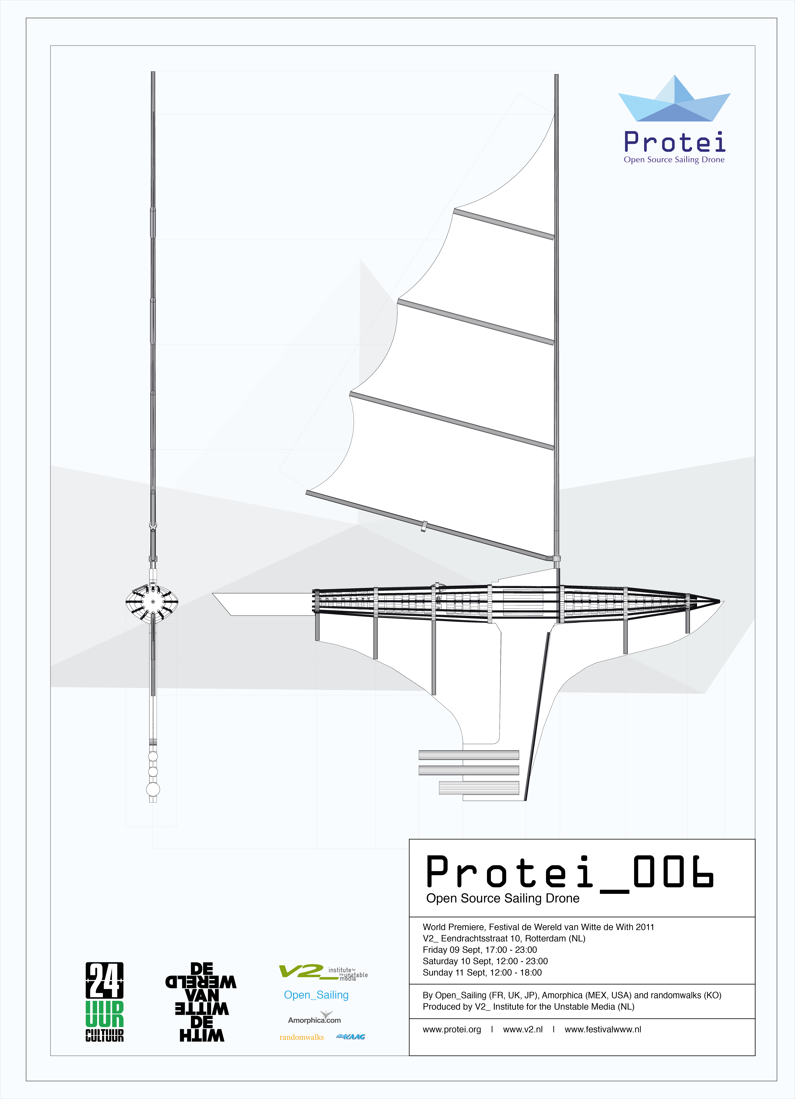
Accelerated Evolution of Sailing Technology
Fast, Economical, Open
New family in ocean robotics
Open hardware innovation driven by global collaboration
Bring together art, design, science, technology, culture
Shared Intellectual property
Easily adaptable to needs and resources (appropriate technology)
Everybody invited to:
Use
Modify
Distribute
In exchange we require to
Credit “Protei”
Contribute to the community

Slide 5
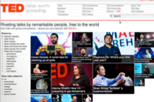
Open Hardware- A Network of Innovation
Protei is developed by an international team of makers, sailors, engineers and scientists as an open-source hardware technology, driving the next wave of ocean innovation.

Slide 6
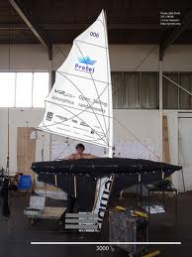
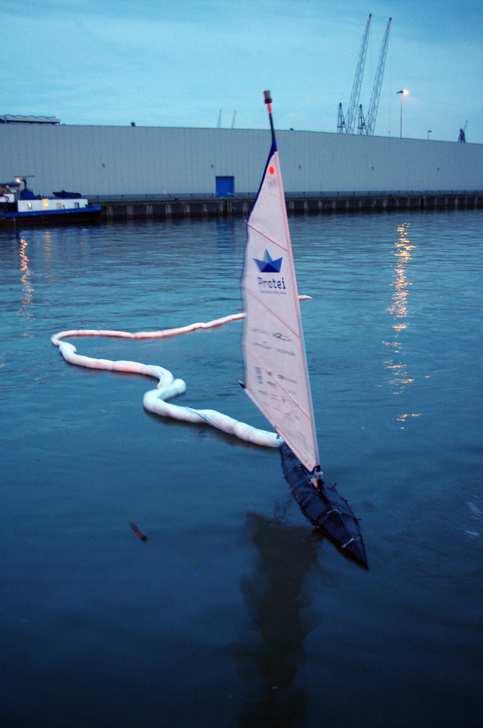
Innovative technology for the Environment
Protei is a pioneering technology of an unmanned shape-shifting sailing robot geared to change how we study, protect and remotely monitor the oceans.

Slide 7
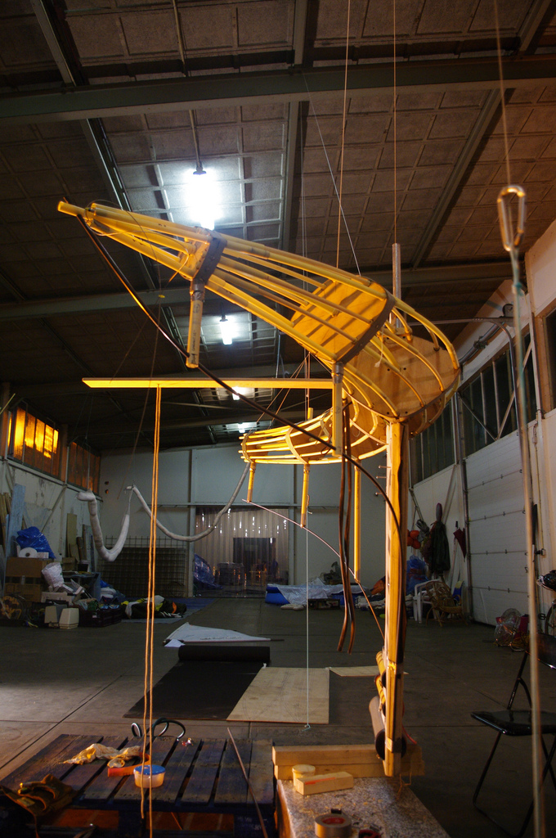
Protei – Simple and Robust Design
Simple and Robust Design
Science, technology, design
Shape-shifting hull
No centerboard or rudder
Entire hull changes shape for wind-powered propulsion
Unprecedented maneuverability, stability and pulling power

Slide 8
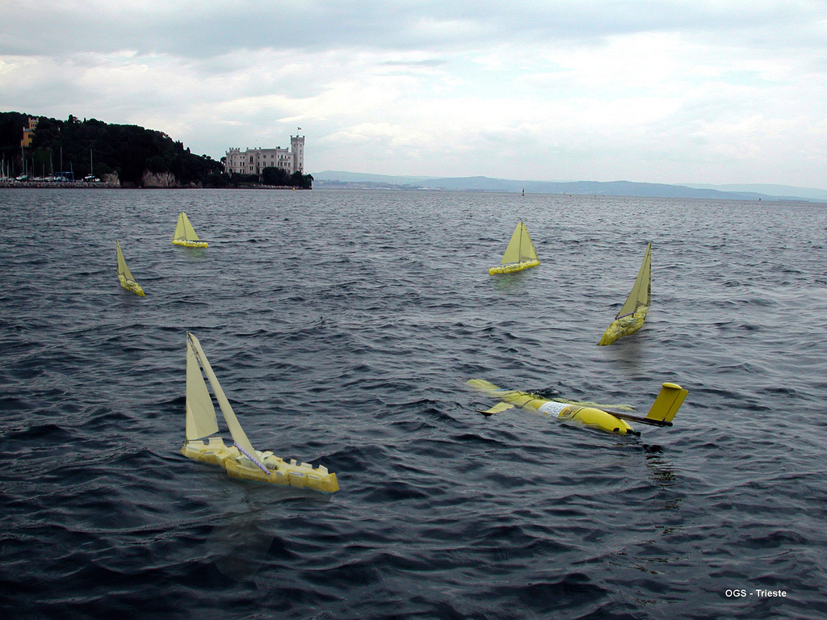
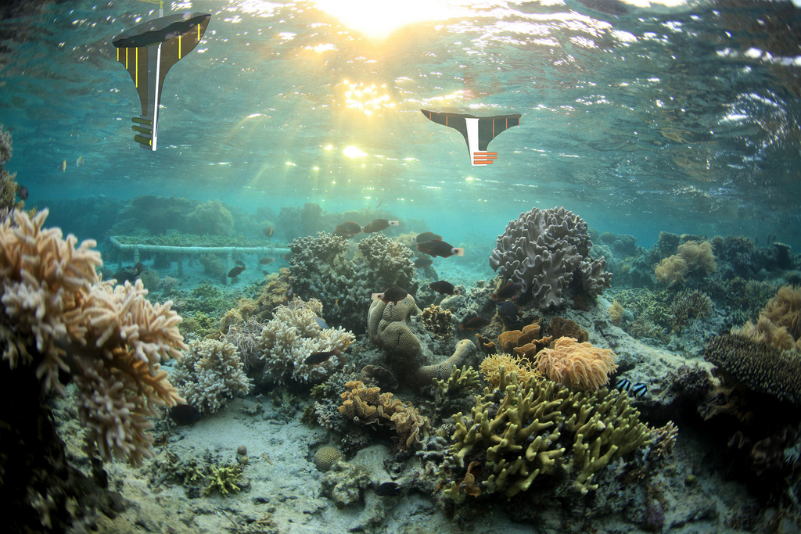
Protei Range of Applications
Advancing research and ocean cleanup
Oil spills sensing and cleanup
Plastic debris sensing and cleanup
Radioactivity sensing
Fishery monitoring
Coral reefs mapping
Natural reserves surveillance
Algae blooms studies
Safety at sea
General oceanography
Astronomy
Climate studies
Relay surface data relay to underwater vehicles

Slide 9
Our ‘Consumer’
Who will use Protei?
Where will Protei be used?
How many people will use it first round of manufacturing?
500
How many spectators do Protei expect?
500,000 minimum, global exposure
Cost of 1 meter Protei to manufacture and ship?
$250
Kids, Hobbyists Scientists Researchers | Governments Teachers Engineers | Hackers, Activists Professionals Designers
At sea by marine laboratories Operated by coastal residents In large lakes by enthusiasts | Universities Classrooms Hackerspaces | Corporate research Environmental activists Roboticists, Sailors
Join a culture of innovation
Increase your international brand visibility
Empower environmental mitigation

Slide 10
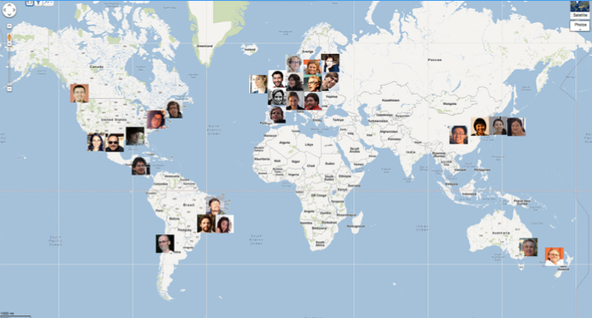
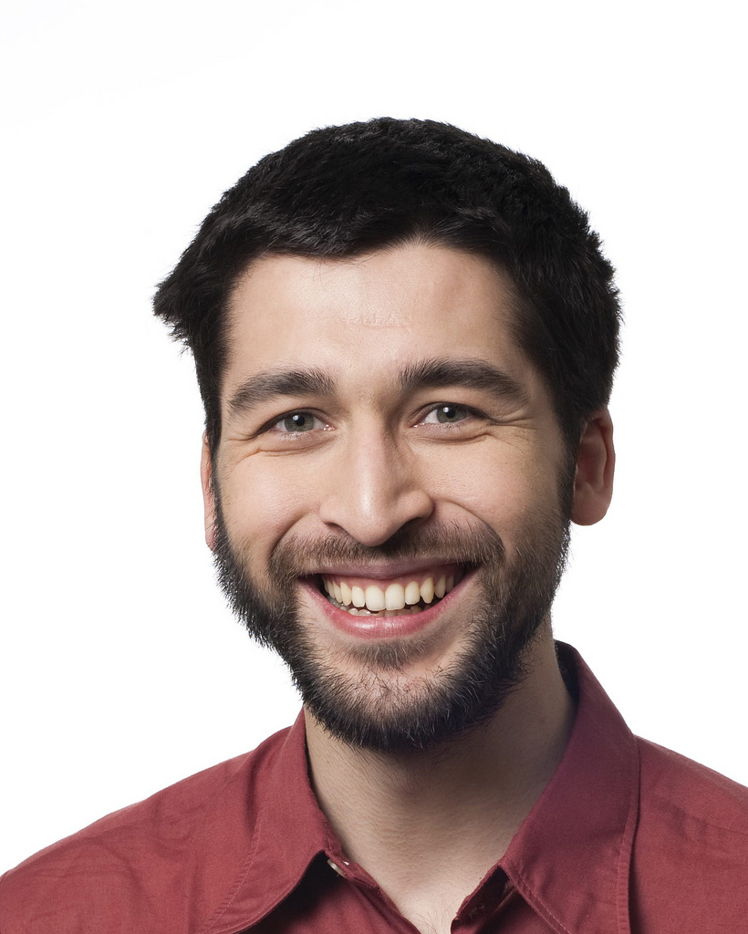
The Protei Team
Cesar Harada, Protei CEO | contact@protei.org | +1 617 230 0662

Slide 11
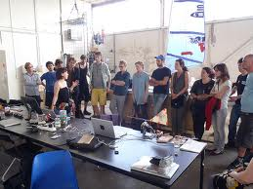
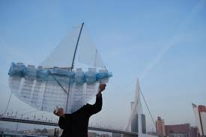
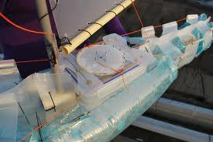
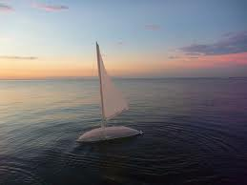
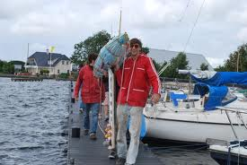
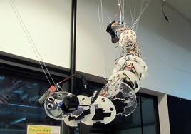
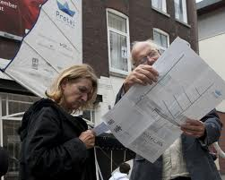
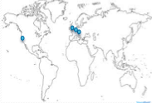
Protei Is Looking To Expand
Protei currently comprises 12+ generations of prototypes, over 30+ active members, countless contributors and soon-to-be users.
We have volunteers operating in 10+ countries and ~10 paid staff.
We are looking to expand staff and facilities in San Francisco, London, Rotterdam, Berlin and Asia.

Slide 12
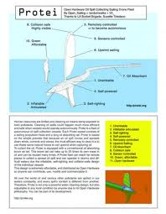
Protei Next Steps
Manufacture & Distribution of Protei
Transition from prototype to product
Get ready to manufacture & distribute Protei on large industrial scale
Anticipate thousands of Protei operating to study and protect the oceans
Develop the web interface to control Protei from a browser, desktop PC, laptop or mobile device, and collect environmental data
2012 2013
Dec
4. Operation & Environmental Sensing
Aug
Oct
Mar
May
1. Development & Testing
2. Manufacturing
3. Online Community Development

Slide 13
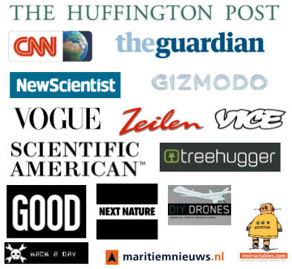
The big opportunity for your brand
By sponsoring this project, your brand will reach millions of people around the world through our extensive media coverage, exhibitions and workshops.
Fast company, Morgan Clendaniel “While things in the ocean move downwind, the genius of Protei's design is that it can tack into the wind without losing power, using a front rudder.”
New Scientist, Jacob Aron “…the first robotic sailors to spend long periods at sea may come from the Protei project, which aims to build autonomous craft for cleaning up oil spills…a unique articulated design.”
Huffington Post
“It's an elegant idea…Harada is showing a new way all of us can take responsibility for risks.”

Slide 14
Become a Sponsor of Ocean Innovation
Protei Sponsorship Opportunity
Limited global sponsorship seats for further development & deployment of Protei 1 meter
Initial three levels of sponsor engagement
1) Visionary 2) Innovator 3) Pioneer
Sponsorship runs August 2012 through May 2013
Key Dates
July 2012: Sponsor Outreach
August 2012 : Sponsor Deadline

Slide 15
Sponsor Options and Benefits
 |  | VISIONARY | INNOVATOR | PIONEER
 |  | $500K+ | $250K-$499K | $25K-$249K
Boat
 | Logo on sail | ✓ | ✓
 | Complimentary boat | ✓ | ✓
 | Logo in video | ✓ | ✓ | ✓
Exhibits & Symposiums
 | Logo during exhibition | ✓
 | Logo during demo | ✓ | ✓
 | Logo in slide presentation | ✓ | ✓ | ✓
 | Logo on banner & signs | ✓ | ✓ | ✓
Website
 | Logo on front page | ✓
 | Logo on sponsor page | ✓ | ✓ | ✓
 | Logo provided for your website | ✓ | ✓ | ✓
Promotional Materials & Apparel
 | Logo | ✓ | ✓
 | Links | ✓
Workshop & Consulting
 | 1 day workshop | ✓ | ✓ | ✓
 | 3 day workshop | ✓
PR & Marketing & Social Media
 | Joint press release | ✓
 | Mentioned in press release | ✓ | ✓
 | Personal quote provided for your PR | ✓ | ✓ | ✓
 | Column in newsletter | ✓
 | Article in newsletter | ✓ | ✓
 | Mention in newsletter | ✓ | ✓ | ✓
 | Logo on social media channels | ✓ | ✓
 | Mention in social media channels | ✓ | ✓ | ✓
 | Dedicated forum or blog | ✓
 | Video placement | ✓ | ✓
Challenge
 | Sponsor challenge for specific solution | ✓
 | Featured project | ✓ | ✓

Slide 16
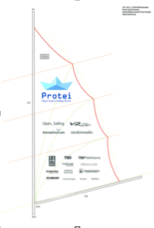
Visionary Sponsorship Overview
As a Visionary Sponsor you will benefit with:
Prominent BRANDING on the boat, website, at events and with our social media channels
Inclusion in PROMOTIONAL MATERIALS
PR and MEDIA exposure
CONSULTANCY and WORKSHOPS
Active involvement in the community via a FORUM and BLOG
Input from community for IDEATION and PROJECTS
Vehicle for MARKET RESEARCH

Slide 17
Visionary Sponsorship $500,000+
Boat
 | Logo on sail | ✓
 | Complimentary boat | ✓
 | Logo in video | ✓
Exhibits & Symposiums
 | Logo during exhibition | ✓
 | Logo during demo | ✓
 | Logo in slide presentation | ✓
 | Logo on banner & signs | ✓
Website
 | Logo on front page | ✓
 | Logo on sponsor page | ✓
 | Logo provided for your website | ✓
Promotional Materials & Apparel
 | Logo | ✓
 | Links | ✓
Workshop & Consulting
 | 1 day workshop | ✓
 | 3 day workshop | ✓
PR & Marketing & Social Media
 | Joint press release | ✓
 | Mentioned in press release | ✓
 | Personal quote provided for your PR | ✓
 | Column in newsletter | ✓
 | Article in newsletter | ✓
 | Mention in newsletter | ✓
 | Logo on social media channels | ✓
 | Mention in social media channels | ✓
 | Dedicated forum or blog | ✓
 | Video placement | ✓
Challenge
 | Sponsor challenge for specific solution | ✓
 | Featured project | ✓

Slide 18
Innovator Sponsorship Overview
As an Innovator Sponsor you will benefit with:
BRANDING on the boat, website, at events and with our social media channels
Logo on PROMOTIONAL MATERIALS
PR and MEDIA exposure
One day WORKSHOP or CONSULTING
Involvement in the community via VIDEO placement
Input from community for featured PROJECT
Vehicle for MARKET RESEARCH

Slide 19
Innovator Sponsorship $250K-$499K
Boat
 | Logo on sail | ✓
 | Complimentary boat | ✓
 | Logo in video | ✓
Exhibits & Symposiums
 | Logo during demo | ✓
 | Logo in slide presentation | ✓
 | Logo on banner & signs | ✓
Website
 | Logo on sponsor page | ✓
 | Logo provided for your website | ✓
Promotional Materials & Apparel
 | Logo | ✓
Workshop & Consulting
 | 1 day workshop | ✓
PR & Marketing & Social Media
 | Mentioned in press release | ✓
 | Personal quote provided for your PR | ✓
 | Article in newsletter | ✓
 | Mention in newsletter | ✓
 | Logo on social media channels | ✓
 | Mention in social media channels | ✓
 | Video placement | ✓
Challenge
 | Featured project | ✓

Slide 20
Pioneer Sponsorship Overview
As an Pioneer Sponsor you will benefit with:
BRANDING on Protei boat video, website, at events and with our social media channels
PR and MEDIA exposure and quote
Mention in online NEWSLETTER
One day WORKSHOP or CONSULTING
Vehicle for MARKET RESEARCH

Slide 21
Pioneer Sponsorship $25K-$249K
Boat
 | Logo in video | ✓
Exhibits & Symposiums
 | Logo in slide presentation | ✓
 | Logo on banner & signs | ✓
Website
 | Logo on sponsor page | ✓
 | Logo provided for your website | ✓
Workshop & Consulting
 | 1 day workshop | ✓
PR & Marketing & Social Media
 | Personal quote provided for your PR | ✓
 | Mention in newsletter | ✓
 | Mention in social media channels | ✓

Slide 22
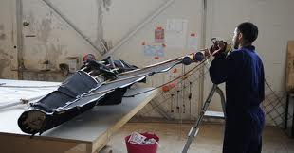
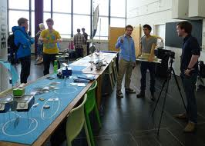
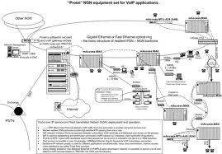
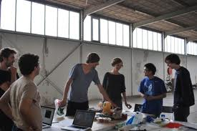
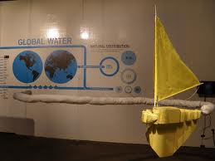
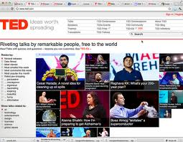
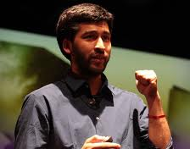
Intended Use of Sponsor Funds
We’re seeking funding to set up manufacturing as we transition from prototype to product.
Funds would help cover business operating expenses which go with any organization, including:
Funding will allow us to:
We also desire to launch OpenH2O, a non-profit open source community for collaborative ocean research.
Your sponsorship will allow Protei to meet these expenses as well as expand our capability to maintain our leadership in ocean research and open source communities.
Bandwidth costs Servers and hardware Legal and accounting Marketing and PR | Research space and office expenses Staff and sub-contractors for administrative, design, project management, research and engineering
Perform pro-active hardware development Enhance our community outreach Sponsor events and user groups | Perform non-code related improvements to projects such as documentation Develop a more comprehensive website Create a consultancy practice

Slide 23
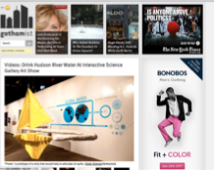
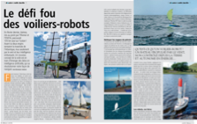
Events & Activities
2010
2011
2012
2013
Tokyo Midtown DESIGN TOUCH, Japan. (3000+ visitors)
Datapolis, Prag, Czeck Republic.
INDAF "Blur”, Incheon, Korea. (5000+ visitors)
Weather Tunnel, International Triennial of Media Art, Museum of Contemporary Art, Beijin, China (3000 people/day for a month)
Cultura Digital Brasil, Rio,Brasil.
NetFab, Ensenada, Mexico.
Wereld van Witte de With Festival, Rotterdam, Netherlands (4000 people/day for 3 days)
Open hardware summit 2011, New York, USA (1500 audience)
Maker Faire NYC, USA
Maker Faire Shenzhen & Beijing, China.
ISEA 2011, Istambul, Turkey.
VIDA Awards for Artifiicial Intelligence and bio-mimicry, Fundacion Telefonia, Madrid, Spain.
Strata Big Data Conference, New York, USA.
Science Gallery, Trinity College, Dublin, Ireland.
V2_ Institute for the Unstable Media, Summer Sessions, Rotterdam, NL ,
Eyebeam Surface Tension Exhibition, NYC, USA.
ARS Electronica “Hybrid Art” Honorary Mention, Linz, Austria.
TEDxSummit: 1700 attendants, youtube views 20,000, ted.com: 160,000+ views, Doha, Qatar.
Dutch Electronic Art Festival Rotterdam (DEAF),Amsterdam, NL
ITHET (International Conference on Information Technolog), Istanbul, Turkey
CIGAC, Rio, Brasil
Aug 11 TEDxItaewon, Seoul, Korea. (1500 attendees)
Sept 17, 18 PICNIC Amsterdam, NL
Sept 18 International Sailing Robotics Conference Cardiff, UK
Sept 20 Savannah Ocean Exchange, USA.
Sept Presenting Protei at the WoodsHole Oceanographic Institute, USA
Oct 6 TEDxParis, France. (1500+ attendees expected).
Oct Trondheim Electronic Arts Center, Norway.
Nov 1 TEDx Trondheim, Norway
Nov 10 TEDxRainer, Seattle, USA.
Dec 2nd TEDxGateway, Mumbai, India
March India Design Festival

Slide 24
Our Supporters
Academic Institutions | Partners | Supporters
Stanford University (USA) MIT (USA) ITP (USA) T/u Eindhoven (NL) Syddansk University (DK) Hongik University (KR) Goldsmiths University London (UK) Southampton University (UK) CIGAC (Universidade Federale of Campina Grande) (BR) Universidade Federale of Rio de Janeiro (BR) | Open_Sailing (www.opensailing.net) V2_ Institute for Unstable Media (v2.nl) DNV (www.dnv.com) Amorphica, Mexico (amorphica.com) RandomWalks, Korea (randomwalks.org) Hofman and Zonen (florentijnhofman.nl) TED (ted.com) TEDxMidAtlantic (tedxmidatlantic.com) Kaag Watersport Academy (dekaag.nl) Creole.com (creole.com) Goldsmiths University, UK (gold.ac.uk) MIT Public Service Center (web.mit.edu/mitpsc/) HTS Consulting (htsconsulting.com) LA Bucket Team Brigade (labucketbrigade.org) Suzette Toledano Becker (suzettebecker.com) | 300+ Kickstarter backers Florentijn Hofman KimEngbers Marnix de Nijs Diana Wieser Dana Braff Jasper van Maede Jean-Grégoire Kherian Earl Scionneaux III Jessica Rohloff Nae Morita Nick Kaufmann Michel Van Dartel

Slide 25
Let’s explore and protect the oceans together.
www.protei.org
Please contact us if you have questions about Protei or our sponsorship opportunity.
Cesar Harada
CEO, Co-founder
Phone +1 617 230 0662
contact@protei.org
Etienne Gernez
Co-founder
Phone +47 468 10 718
etienne@opensailing.net

