Slide 1
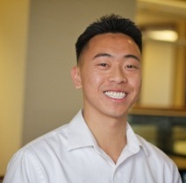
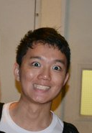
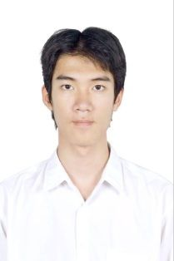
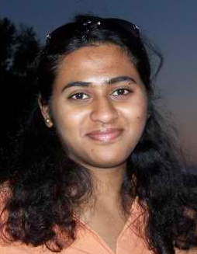
OpenH2O
The Community for Oceanic Innovation
Team ProteUS
Allen
Congyi
Shwetha
Ken
Notes:
OpenH2O is a unique company
It was all our first choices to work with because of that
We’d like to go around the table again to explain those motivations..

Slide 2
OpenH2O Mission Statement
We believe technology will change the world
We enable our community to produce solutions for oceanic development
We create innovative products such as Protei, an open source sailing drone, designed to clean oil spills
Notes:
With that, OpenH2O’s mission statement is compelling

Slide 3
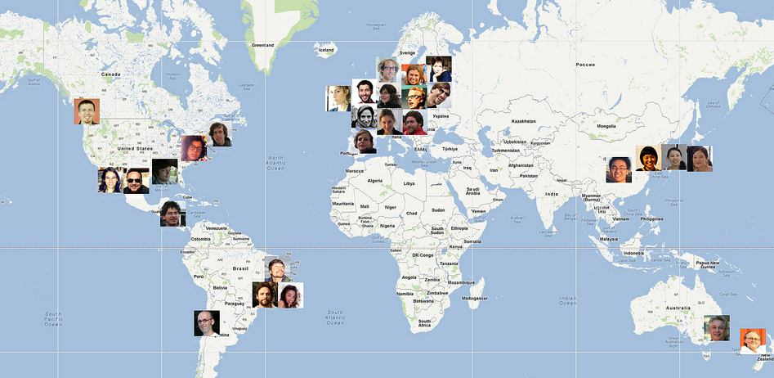

OpenH2O – A Global Community
Notes:
What is OpenH2O?
A global community of like minded individuals who are passionate about using technology to improve our ocean
As a team, we share that same passion.

Slide 4

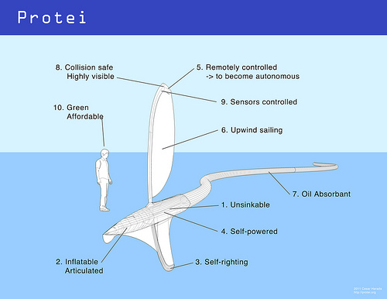

OpenH2O Vision and GEM Goals
Create innovative products such as Protei
OpenH2O Vision
Enable an online community for oceanic innovation
GEM Goals
Advise on marketing strategy to enable OpenH2O’s vision
Market Research → Analysis → Conclusions → Recommendations
Notes:
Starting with the big picture, OpenH20’s vision..
Provide information and latest updates about OpenH2O and its projects
Online community platform for people to collaborate on projects
Our goals as your marketing team.. (is to make that happen)
Our ultimate goal is for the online community is to create..

Slide 5
The DE-DART Framework
Diagnosis – What is the problem/opportunity?
Experience – How will users experience change?
Decision – What is our plan of action?
Analysis – Why is our plan the best choice?
Reality Test – What are the risks? How to manage them?
Notes:
We approached our goals through the DE-DART framework
In each step of the way, we will break down for you..

Slide 6
Tools and Methodologies
Notes:
Through the different steps we used these tools and methodologies..

Slide 7
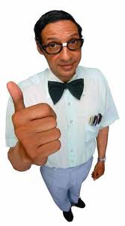

Diagnosis: The Opportunity
DE-DART
Tools Used
Technology Adoption Life Cycle (TALC)
Identifying the market

Slide 8



DE-DART
Where is OpenH2O on the TALC?
Research Institutions
Sponsors
Students
Technologists
Enthusiasists
Innovators
Early Adopters
Early Majority
Late Majority
Laggards
Source: Moore (1991, 2002), Crossing the Chasm
Notes:
Through our discussions with Cesar and Etienne, surveys, research, and analysis, we have concluded that OpenH20 is.. On the TALC
DIYDrones and instructables are in the early adopters stage because they have a basic community around them
KickStarter has crossed the chasm, they have significant traction among the technologists and enthusiasts, have scaled to reach the students, the attention of research institutions, and received funding from VCs.
With our help, we want to drive OpenH20 across the chasm.
Innovators – Techies: try it!
Early adopters – Visionaries: get ahead of the herd!
Early majority – Pragmatists: stick with the herd!
Late majority – Conservatives: hold on!
Laggards – Skeptics: no way!

Slide 9
The Market Opportunity
DE-DART
Initial hypothesis: the market landscape has 5 buckets
  Technologists
  Enthusiasts
  Students
  Research institutions
  Sponsors
We will Teach You How to Fish
Notes:
New Slide:
Examples of the ideal person apart of the community

Slide 10

Personas
Technologists
Expertise in
            Marine engineering
Communications
Sensors and Actuators
Mechatronics
Robotics
Passionate about oceans
Meaningful Ways to Engage Them
  Promote to people interested in open source technologies
  Build a better website
  Organize conferences and call for people
  Competitions

Slide 11

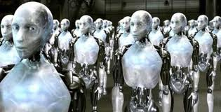

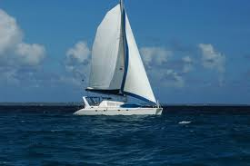


DE-DART
Personas
Enthusiasts
Hmm….Wonder if I should attend the robot conference tonight???
Notes:
ENTHUSIASTS
Profile and Characteristics
Includes students and technologists
Passionate in sailing/ocean/technology
Curious and eager to learn
Desire to make change in the community and envionrment
Recognition of their contributions to the projects is a plus
Likely Groups and Associations
ASA – American Sailing Association
TED global audience
Robotics and Artifical Intelligence Groups
Marine engineering groups
Open source communities
Where to Find Them?
Universities – groups/associations
Sailing organizations
Professionals in the technology industry
Groups on Linkedin and Twitter
IEEE – Institute of Electrical and Electronics Engineers
Meaningful Ways to Engage Them
Technology information and demos
Incentives and recognitions for support
Organize competitions and award prizes
Promote open source technologies
Build a better website
Organize conferences

Slide 12

Personas
Students
Looking for academic knowledge
Eager to study about new technologies
Interested in competition
Meaningful Ways to Engage Them
  Provide a platform where they can easily find out information about technologies
  Organize competitions and award prizes

Slide 13
Personas
DE-DART
The Research Institutions
Mostly academic in nature
Build brand name as top priority
Recognition by having their work published/getting invited to give talks
Meaningful Ways to Engage Them
  Provide a visible platform for them to promote researches
  Provide ways to acquire resources to do researches
  Provide a platform to facilitate collaboration across institutions
Notes:
NPOs
Regulatory bodies

Slide 14

Personas
Sponsors
Companies, businesses, and/or organizations
Similar mission statement
Believes in improving the environment by collaboration and innovation
Looking for win-win
Quid quo pro
Meaningful Ways to Engage Them
  Demonstrate value
  Show the various levels of sponsorship and what each level entrails
  Increased sponsor visibility, press releases, teaching the community about the sponsors

Slide 15



Experience: Users Feedback
DE-DART
Tools Used
Market research
Surveys
Interviews
1:1 Diagnosis
Notes:
Experience is about the users, finding out how they think, their barriers, incentives, and what their pain points are
Within here, we used these tools..

Slide 16
Market Research Methodologies
DE-DART
Web Survey
Quick 2 minute SurveyMonkey questionnarie
Goal: collect feedback from the community
1:1 Interviews
30 - 60 minute long in depth discussions with industry experts on the current state, proposed plan, and long term vision of OpenH2O
Notes:
(Explain the steps we took for market research)

Slide 17
Web Survey Breakdown
DE-DART
Basic demographics
Total participants: 60
Average age: 33
Male/Female: 57/43%
Email addresses provided: 50%
Phone numbers provided: 27%
Notes:
We had great success with our web survey and the tools is still up and running
Here are some basic demographics..

Slide 18
Web Survey Results
DE-DART

Slide 19
Web Survey Results
DE-DART
Notes:
We received a diverse set of participants

Slide 20
What They Had to Say
DE-DART
Best responses:
“I never heard of you before, but I loved what I read”
“If there is [anyway] I can help, please let me know”
“I am a marine engineer.. The ocean is my life”
“How can I create a hub here in Lancashire?”
“[Do] your boats add to the plastic debris?”
“Keep the website uncluttered”
“Good luck, we need this”

Slide 21
“Where to Find Others Like You?”
DE-DART
Answered by 35% of participants
Notes:
Network example - Network for Social Change, will put us in touch

Slide 22
“What gets you interested?”
DE-DART
Notes:
Network example - Network for Social Change, will put us in touch
Other: Opportunity for positive collaboration - meeting other great minds and working together to tackle the big engineering and environmental issues.

Slide 23
Respondents Most Want to See
DE-DART
Notes:
Explain:
You have to tell people about what you do - just doing, without shouting it into the world, will not get new people interested in your mission. Cool videos, edutainment on what you are doing and why, will help your mission!
I think every component would appeal to a different community, and the things you list are very exciting

Slide 24
“What do you find interesting?”
DE-DART
Notes:
Other:
I don’t know what green blooms is; so another one: defining/educating about ocean concerns
Distributed sensor networks, Artificial Intelligence and Control

Slide 25
“What involvement interest you?”
DE-DART
Notes:
Other:
Hi Ive been a follower of open_sailing for a while since you were part of a FutureEverything award, a festival I used to work with I'm organising a marine research pilot project between Liverpool UK and Norway (NO) in 2013 specifically marine hackspaces with artists, software developers, scientists and DIY makers culminating in a sea bound journey from Oslo to Liverpool in 2014. If there was a way for the protei project to take part at a hackspace we could provide travel, a research outline fee and accomodation at coastal studios in the UK and Norway. So this could contribute financially rather than kickstarter. We are looking to keep an open source ethos to the project and do not want to own any of the work developed; its more about supporting spaces for practice based research. Im also organising an open hardware summit in august 2012 with OpenLabs at John Moores University in Liverpool and potentially we would welcome someone from the project to present there and could cover travel, accomodation and some sort of presenter fee. This would be part of http://oggcamp.org/ a conference on open source culture. Clearly this may be too close to August to set this up but I thought it may be worth mentioning. please get in touch if you are interested ross@cheapjack.org.uk A truly amazing project. Im now obsessed with marine drones and have been blogging about your work best ross PS Other invited people to the research pilot, which is still at a fundraising stage include http://owlproject.com/flow , Juha of http://shippr.org/ and Jana Winderen

Slide 26
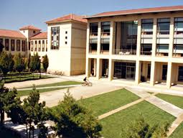


1:1 Interview Breakdown
DE-DART
Research Institute / Technologist
Kevin Arrigo, Stanford Oceanic Group
Sponsor
Catherine Ford, Nokia
Enthusiast / Student
Patrick Gallagher, Anthropology PhD
Notes:
We’ll talk about some of the findings here. Lots of the information we gathered are spread through out our presentation

Slide 27
1:1 Research Institute Interview
DE-DART
Feedback on OpenH2O and Protei?
No real community like this exists
Protei and OpenH2O is a bit unclear
The word has to get out
Needs clearer message people can identify with
Would you use Protei?
No, we don’t do things with oil spills
Only if it could sample more than surface
Remote sensing
Notes:
Interview Notes
Takeaway: Stanford Oceanic Group collects data and analyzes the ocean for research. They will find value in OpenH2O if it helps them identify providers of the technology and equipment they need for their research, for example the optical equipment makers. To take it a step further, instead of asking these providers “what do you have that I can use in my research?” it should be “what does everyone have that I can use and suggest improvements to build on top of it?” In the end, the researchers provide the motivations for the equipment makers. The value is that OpenH2O is a marketplace for buyers and sellers, where the buyers can tell the sellers what they want, thus enabling innovation through community collaboration.
Q: What does the Stanford Oceanic Group do?
Going out on ships, making measurements, analyzing water samples
Use gliders, automated underwater vehicles
Explore environments that are icy
Will go to companies to buy optical instruments to do certain things
(How do you know where to go?) word of mouth, not that many companies building oceanic equipment
Google search: “oceanic equipment,” “optical equipment,” “gliders,” “oceanographic instrumentation”
Biospherical instruments - san diego
Satlantic - novascotia
Wetlabs
Hobilabs
Q: What would make you buy these products to help your research
It cost money to develop and build things
Demonstrated ability to work
Price
Would want to buy and own the product
Q: Feedback on OpenH2O and Protei?
Protei and OpenH2O is a bit unclear
No real community like this exists
Gap in terms of people who want to develop vs those who need
OpenH2O can serve to fulfill that need
The word has to get out
Needs to provide a clear message that people can identify with, can find it useful
Q: How would OpenH2O benefit you?
Help move my research in the right direction
Make a measurement easier or possible
Q: How would you contribute to the community?
Providing motivation for building the technology and equipment
If it’s not built yet, would want to collaborate to develop the product
Q: Would you use Protei?
Would use it if:
Samples more than surface
Temperature for fluorescents, currents
Currently no, doesn’t do anything with oil spills
Remote sensing - having a fleet measuring ocean temperature
GPS, upload data
Capability to measure subsurface, gliders
Sensors
Q: How can we talk to more people like you? Who else is this data valuable to?
Set up a booth at a meeting of oceanographers
Talk to all kinds of people
Will find lots of commonalities - what can be measured, what can’t
Not a long list of what people want
Could even help physics
Contact societies/groups/organizations
Ocean sciences meeting in Utah
TOS (The Oceanography Society)
American geophysical union (ocean section)
American society of Limnology and oceanography
NSF (National Science Foundations)
Argo buoys program - drifting all over the ocean, everyone gets data from here; expendable
Not many people fighting over data, but you want to get it published
Q: How could we form a partnership?
Wouldn’t necessarily form a partnership with the Stanford Oceanic Group because they are more of just a collection of scientist
Research is done with individual researchers, not institutions
Some people might disagree and not care about this
Easier/better to do this as individual researcher
Lots of collaboration going on
Oceanographic societies would be interested in something like this

Slide 28
1:1 Research Institute Interview
DE-DART
How to form a partnership?
Oceanographic societies would be interested in something like this
Wouldn’t really form a partnership with the institution because they are just a collection of scientists
Easier and better to work with the individual
Notes:
From this interview, more identification of how to find and connect with research institutes are discussed later

Slide 29
1:1 Sponsor Interview
DE-DART
Takeaway: OpenH2O and the sponsor will have to be aligned with the same goals
Benefit for the sponsor?
Increased visibility
Listed in press releases
Access to audience and user base
Notes:
Sponsor interview notes
Q: Why would a company want to sponsor a business?
Have to be in alignment with what the goals were
i.e. Nokia to sponsor non-profit Bemic
Gave grant
Because provided a platform for our group to get in front of an audience we wanted to gauge with
Visibility on their website
Logo was posted on sponsor page
Provider speakers, judge, for contests
Training, branding, awareness
Access to audience we wanted to get in touch with
Navteq wanted to find new innovation
Bemic worked with student entrepreneurial teams that were coming up with cool innovate maps
We’d like to work with your students
To use our product
Technologies
If a product came out to market Navteq could be the mapping tool
At that time, team was offering a global projects
Bemic was working in the same space, launching own contests, challenge, perfect fit
Non-profit, needed startup money
Gave direct in
Win-win situation
Q: Result of the sponsorship?
Increased visibility
Mobile world congress
Listed in press release
Lecture at class at Berkeley
Considered founding member of organization
Q: Did you find them? Or they find you?
Just this one at this point and time
Navteq creating university program
Matter of good timing
Didn’t do more because of bandwidth
Q: What measurements do you need to ‘check off the list’ to select organization?
Very high level
Being a judge
Included in press release, lectures
If we had been in existence
Clicks to website
But wasn’t that evolved yet
Q: Level of sponsorships
Bronze: dollar amount
Kickstarter community
Pitch to company, they need to know how much this will cost, what they get out of it
Q: Risk involved
Didn’t see much risk
Pretty straightforward
Q: Is there a need to make a sponsorship?
Protei would have to create it as a program
Actively seek out
Which level of sponsorship investment they want
Q: Where would sponsors fall into the picture?
Protei already has publicity
Companies might already want to contribute
Development and sponsorship could come in parallel
Not a specific order
Q: What would make you go to website
If were reaching target audience
Getting click throughts
Customer base of company
Q: OpenH2O could monetize
Selling their product
Develop technology
Spin off products
Protei is a for-profit company
Q: Additional comments
Seperate out Protei and OpenH2O
See them as different projects
Seperate sponsorship packages
See if there are entrepreneurial groups within there
Prioritizes plan of approach
Win-win
Quid quo pro

Slide 30





1:1 Sponsor Interview
DE-DART
Action for OpenH2O to receive sponsorship?
Create a program for sponsors
Actively seek them out
Different levels of sponsorship (kickstarter method)
Feedback on Protei and OpenH2O
Separate the two
Communicate a clear win-win situation
Notes:
Sponsor interview notes
Q: Why would a company want to sponsor a business?
Have to be in alignment with what the goals were
i.e. Nokia to sponsor non-profit Bemic
Gave grant
Because provided a platform for our group to get in front of an audience we wanted to gauge with
Visibility on their website
Logo was posted on sponsor page
Provider speakers, judge, for contests
Training, branding, awareness
Access to audience we wanted to get in touch with
Navteq wanted to find new innovation
Bemic worked with student entrepreneurial teams that were coming up with cool innovate maps
We’d like to work with your students
To use our product
Technologies
If a product came out to market Navteq could be the mapping tool
At that time, team was offering a global projects
Bemic was working in the same space, launching own contests, challenge, perfect fit
Non-profit, needed startup money
Gave direct in
Win-win situation
Q: Result of the sponsorship?
Increased visibility
Mobile world congress
Listed in press release
Lecture at class at Berkeley
Considered founding member of organization
Q: Did you find them? Or they find you?
Just this one at this point and time
Navteq creating university program
Matter of good timing
Didn’t do more because of bandwidth
Q: What measurements do you need to ‘check off the list’ to select organization?
Very high level
Being a judge
Included in press release, lectures
If we had been in existence
Clicks to website
But wasn’t that evolved yet
Q: Level of sponsorships
Bronze: dollar amount
Kickstarter community
Pitch to company, they need to know how much this will cost, what they get out of it
Q: Risk involved
Didn’t see much risk
Pretty straightforward
Q: Is there a need to make a sponsorship?
Protei would have to create it as a program
Actively seek out
Which level of sponsorship investment they want
Q: Where would sponsors fall into the picture?
Protei already has publicity
Companies might already want to contribute
Development and sponsorship could come in parallel
Not a specific order
Q: What would make you go to website
If were reaching target audience
Getting click throughts
Customer base of company
Q: OpenH2O could monetize
Selling their product
Develop technology
Spin off products
Protei is a for-profit company
Q: Additional comments
Seperate out Protei and OpenH2O
See them as different projects
Seperate sponsorship packages
See if there are entrepreneurial groups within there
Prioritizes plan of approach
Win-win
Quid quo pro

Slide 31
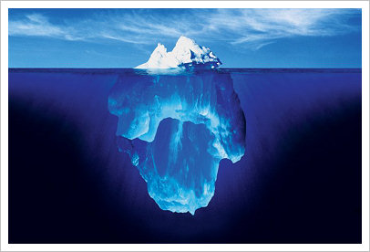
The A-Ha! Moment
DE-DART
Notes:
Through these surveys, interviews, and data collection, we came to the wonder A-Ha! Moment. Which we’ll get to in a minute.

Slide 32
DE-DART
1:1 Diagnosis
Communication Problems:
I didn't know of OpenH2O
I don’t understand you.
Professional Silos
Motivation Factors:
What’s in it for me?
Skill Gaps:
I don’t know how.
Gender Chasm
Generation Chasm
Culture Chasms
Principles & Values Clash:
It’s against my principles and values!
Personality Differences:
That’s the way I am. It’s hard to change.
External Constraints:
I don’t have the time, money or authority.
Source: Kosnik, Blair, Ramfelt, and Pfeifer (1986, 2000, 2005, 2009) “1 to 1 Diagnosis.”
*
*
Notes:
Our studies show that people are not adopting OpenH20 primarily because..

Slide 33
Decision: The Recommendation
DE-DART
Tools Used
Creating a new ecosystem
Bucket analysis
Positioning statement
Mapping out the whole product
Notes:
So what does this all mean.. Here’s where you want to pay extra close attention. We have used these tools to form our recommendation.

Slide 34
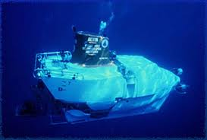
The New Ecosystem
DE-DART
??
Research Institutions
??
Oceanic Equipment Providers
Notes:
Problem: Oceanic research institutions buy their equipment from disparate providers. They make purchases by word-of-mouth and have no efficient way of comparing prices, equipment functionality, or communicate what other tools they need. This is one major reason why oceanic development is so slow.

Slide 35
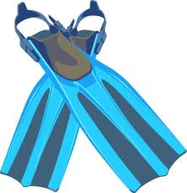

The New Ecosystem
DE-DART
Sponsors
Enthusiasts
Research Institutions
Sponsors
Oceanic Equipment Providers
Notes:
Problem: Clearly, there’s a significant gap in the market. And it shouldn’t be this way. There should be something to fill this market need.
Solution: Create an Amazon.com like marketplace for the buyers and sellers of oceanic equipment. Buyers would be research institutions and sellers would be the oceanic equipment providers.
Then: Bring Enthusiasts (students/technologists) to the community who will contribute and innovate to co-designing, licensing, and sharing data
Market: Many major universities, such as Stanford, have oceanic research groups that make large purchases. Large energy corporations have a need to stay competitive through innovation. Governmental agencies, such as the EPA and National Science Foundation have a desire to conduct ocean research. This is a large and niche market.

Slide 36
New Ecosystem Relationship
DE-DART
 | Research Institutes | Equipment Providers | Enthusiasts
Technology
Revenue
Information
Reputation
Manpower/ Expertise
Equipment
Equipment
$$
$$
Feedback
Research Findings
Third-party/Independent Data-sets
Independent Data
Visibility
Visibility
Potential Talent Pool
Notes:
Equipment provider examples (before this slide) and research institutes
List as appendix or supporting doc
This matrix highlights the relationship between the three buckets.
You’ll notice that, as we go down the list, when one group provides, the others benefit
It is this kind of ‘quid pro quo’ ecosystem that we need to build, where you scratch my back and I’ll scratch yours
Firstly, under technologies, equipment providers supply the instrumentations and research apparatus to the other two groups,
And in return, they receive revenue to grow their business
The field of information is the where the most intricate exchanges happen.
Equipment Providers, being subject matter experts, can and do have the knowledge to pass on to the research institutions to improve their research methodologies. Research Institutions and enthusiasts, who use the equipment that these equipment providers sell, can give feedback on which features to retain, improve or discard.
Research Institutions and enthusiasts form a nice synergy in this area too. Enthusiasts craving for new interesting findings or projects to work on can depend on research institutions to provide them. Research Institutes who need independent data to support their claims can recruit enthusiasts to provide a second pair of eyes.
Reputation is key for equipment providers, whose niche business depend on good referrals and that is where research institutions and enthusiasts come into play. Imagine if your autonomous submarine becomes endorsed by the Stanford Oceanic Research Group, or a product you sell goes viral on Youtube because an enthusiastic user found a really cool way to use it and uploaded it. The amount of visiblity your company can gain will be breathtaking
Last but not the least,

Slide 37
DE-DART
Positioning Statement
For research institutions, oceanic equipment providers, and enthusiasts
Who believe in technology to improve the ocean
OpenH20
Is an online collaborative community
That brings together like-minded people with diverse skill-sets and backgrounds
Unlike the currently fragmented system
Our product takes an integrated approach at co-developing, licensing, and sharing in an inclusive environment.
Source: High-Tech Marketing © 2005, TCG Advisors LLC
Notes:
Knowing the kind of tightly knit ecosystem that we aim to build, here’s the positioning statement that sums up our goal for OpenH2O.
With this in mind, I shall move on to talk about how exactly we are going to achieve this.

Slide 38
Decision: Timeline
DE-DART
Short
Mid
Long
Build The Community
Grow The Community
Spin-off Technology
Notes:
Short Term: MVP - build community
Medium: Delight
Long Term: Spin off technologies

Slide 39
DE-DART
Building the Community
Whole Product Model
Research Findings / Columns
Open Source Collaboration
Tutorials & DIY
Competitions
OpenH2O
Events Calendar
Jobs / CV Repository
Forums
Social Media Integration
Short
Source: High-Tech Marketing © 2005, TCG Advisors LLC
Notes:
Cite the source
What is the focus NOW. The MVP
Highlight current arrow
Building the minimum viable feature set. Just like every structure needs solid foundation, the minimum viable product is the core set of features that we think should be on OpenH2O when it launches such that visitors to the site are attracted to it, and REMAIN attracted to it.
How we decided on this set of features is done through our market research, which includes 2 methodologies: surveys and best-practices.
In our survey, we asked our surveyees what features they wanted most, and in what areas they felt most comfortable contributing to. In addition, we also took a look at some of the best practices that other successful online communities exhibit and incorporated them if we felt they could make a significant impact.
In our analysis, we will explore a few of these factors in detail

Slide 40
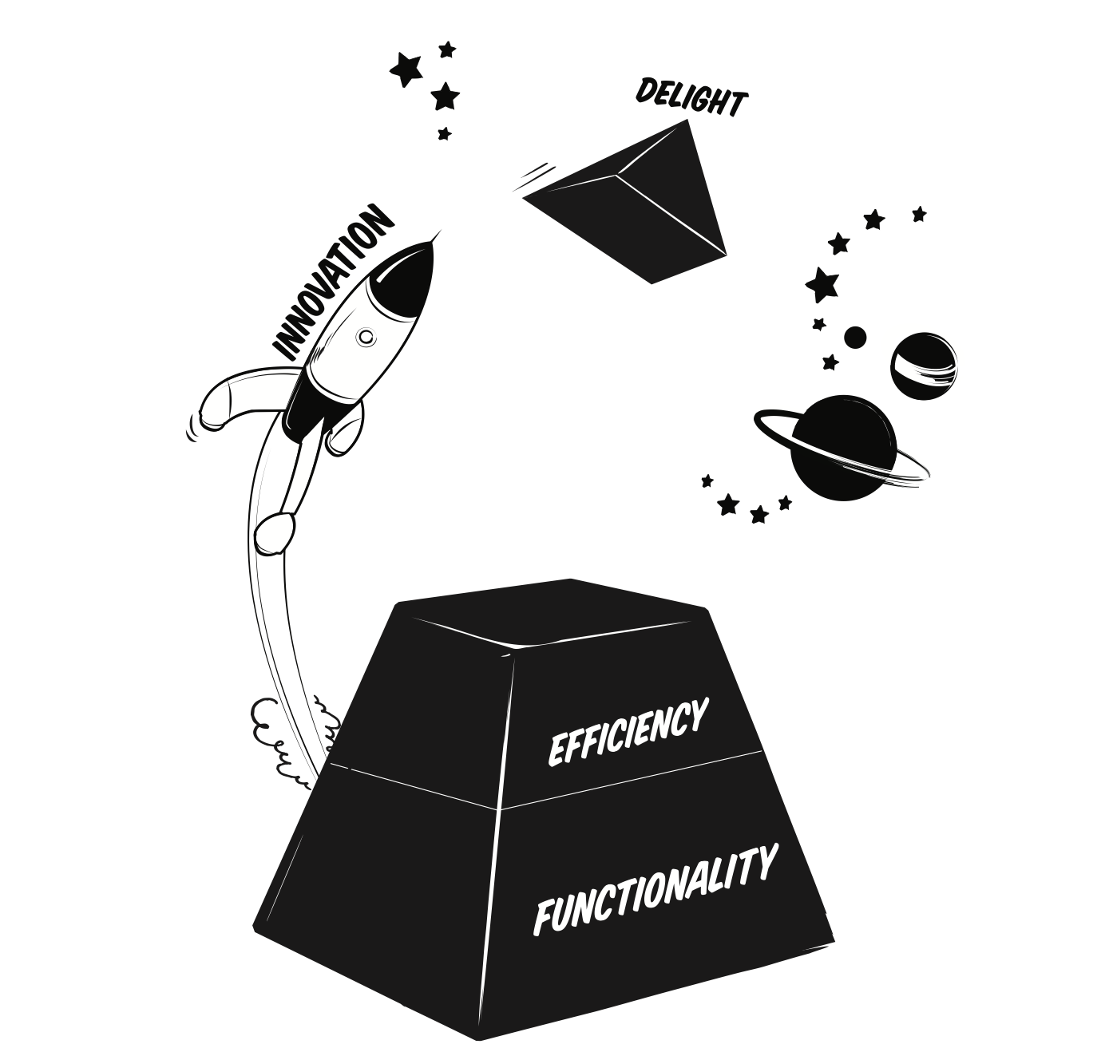
DE-DART
DE-DART
Decision: Growing the community
Building on top of our Minimum Viable Product
Using the features to grow content
Leveraging on community
to grow even more
user-generated content
Source: Kosnik, Blair, Ramfelt, and Pfeifer
Using the content to attract user participation
Mid
Mid
Source: Ramfelt, Kjellberg, and Kosnik (2012) “Gear Up: Your Best Idea Ever”
Notes:
But as I mentioned, building the minimum features isn’t enough.
We need to curate content, and using the features that we have, reach out to our buckets and get them involved.
Being a community portal, the content we put up should probably include a social element to it. We want to encourage a two-way dialogue, or even a many-way discussion instead of a one-way monologue.
Evident especially on the social media front, this technique of sharing has a good chance of achieving virility.
Later on, we explore the different motivations and strategies behind how social media can help us in content creation.
Competitions
Other things to grow community
Contests, Industry sponsored (NASA)
Speaker conferences (movies BlueOcean s

Slide 41
Decision: Long-term goals
DE-DART
Doors that open when community is mature:
Seek corporate sponsorships
Incubate potential start-ups
Long
Notes:
The last stage kicks in when we have the numbers to show.
This is when it’ll be easier for us to seek VC funding, sponsorships.
It is also when we have the reputation and resources to incubate other startups which have goals aligned with ours. That will open up even more doors for OpenH2O to expand its breadth of operations.
This stage is still a distance away. What we have highlighted here probably only represents a slice of what is possible. At this stage, we would have gone over and beyond a go-to-market strategy, and may require us to employ a different set of

Slide 42
Analysis: Deep Dive
DE-DART
Why these are the best choices
Ecosystem analysis
Clear branding
Social media strategy
Website strategy
Desired content for OpenH2O
Partnerships

Slide 43
DE-DART
Ecosystem Analysis
Notes:
Analysis should start off with bucket analysis
Step 1 in GTM is identifying buckets
Decision should just be hypothesis
Increase font size
Belongs in Analysis

Slide 44
DE-DART
Connect Rather Than Convince

Slide 45
DE-DART
Connect Rather Than Convince

Slide 46

Personas
DE-DART
Oceanic Research Equipment Providers
Profit-centered, B2B nature
Niche market; Highly specialized
Subject Matter Experts
Meaningful Ways to Engage Them
  Help them acquire leads
  Assist in building long-term relationships
Notes:
The new persona

Slide 47

Clear branding
DE-DART
Clear message - separation between OpenH2O and Protei
  Products: Protei
  Community: OpenH2O
Survey and interviews of people confused
Notes:
Visualize this slide
(Question mark/light bulb)

Slide 48
Social media strategy
DE-DART
Why?
Extends the brand, and its relationship with the customers.
Provides instant feedback.
Encourages two-way communication.
Leads to Other Valuable Sources of Traffic.
Sources:
http://img.constantcontact.com/docs/pdf/why-social-media-marketing.pdf
http://traffikd.com/smm/worth-your-time/
29% of the survey participants mentioned social networks as a medium to find people.

Slide 49




Social Media for OpenH20
DE-DART
Notes:
Facebook – 750 million users
Twitter – 200 million users
Linkedin – 100 million users
Developing strategies to reach out to this huge audience base will help OpenH20 grow in the long run.

Slide 50
Twitter for OpenH2O
DE-DART
Twitter profile created on May 10th 2012 – Currently has 43 followers
Most important followers:
David E. Guggenheim– Marine scientist, conservation leader, sub pilot, speaker, educator, author. Sr. Fellow at The Ocean Foundation. Host, The Ocean Doctor http://oceandoctor.org
New Ocean Blue - New Ocean Blue educates about oceans’ garbage patches, uses grassroots tactics to eliminate plastic pollution,& promotes use of reusable materials.
Green Garmento ‏ - develops reusable dry cleaning bags
LMR ‏ - World's biggest robot building community and robot news from around the world.
Seadub ‏ -Marine Engineering Company based in Southampton servicing yachts and boats in the Solent area.
CodeMyDesigns.com – Develops Drupal websites for designers and agencies.
Mike Larsen ‏ -Tweets the latest and greatest in Space and Science News! - NASA Information & News, Space, Astronomy, Science, Technology, Earth and the Environment
Mystery Bay Marine - Internet retailer of quality boating and industrial products. Veteran owned and operated small business
Clean Ocean Action COA's mission is to improve the degraded water quality of the waters off the New Jersey/New York coast.
Drupal Bangalore ‏ - Helps companies build websites with Drupal
Ken Wisnefski ‏ -Serial Web Entrepreneur and Founder and CEO of WebiMax a leading global #SEO Company. Expert in online marketing, small business, start-ups, and leadership.
Notes:
Potential sponsors:
David Guggenheim
Kevin Wisnefski
Mystery Bay Marine
Potential Partners:
New Ocean Blue
Green Garmento
Seadub
Clean Ocean Action
Gold Zlato conquest
Potential Co-developers:
CodeMyDesigns
LMR
Drupal Bangalore

Slide 51
Distribution of Followers
DE-DART

Slide 52
Potential Twitter Audience
DE-DART
Notes:
Out of the 200 million users on twitter, we have identified the groups shown above that form the potential partner/collaborator base for OpenH20.
There are quite a huge number of people associated with these groups as shown below:
Ocean groups 20000+ people
Open source communities 10000+ people
Technology groups 20000+ people
Media sites/marketers 20000+ people
Strategies are to developed to tap into this audience base to build the community for OpenH20

Slide 53
Similar Communities on Twitter
DE-DART
DIY Drones: The world's largest amateur UAV (Unmanned aerial vehicles ) community
3867 followers
Average of 14 tweets/week
Post industry related links and products from DIY drones
Model OpenH20 community after DIY drones
Source: https://twitter.com/#!/DIYDrones

Slide 54
Experimental Results - Strategy
DE-DART
Use # tags with keywords. Ex: Drupal, clean ocean
Find people with similar interests and follow them. Ex: ocean groups, non-profits, open source communities.
Tweet on a regular basis – at least 2 tweets a day
How to get people to follow?
Post survey on different groups
Provide access to team members to tweet
Call for people from different groups to collaborate with OpenH20 community
Implement Twitter button on the website
Notes:
Received messages from people such as David Guggenheim and Mystery Bay Marine expressing interest in sharing information.

Slide 55
Facebook for OpenH20
DE-DART
How to increase visibility?
  Experiments and Strategy
  Protei page already created – Dec 21st 2011- Currently has 37 people associated
  Find ocean groups and share Protei page
    So far 3 groups found, with more than 50000 people associated
  Share survey on these groups
    Shared survey with impressive response
  Invite people from these groups to join OpenH20 community
  Implement Facebook “like” button on the website

Slide 56
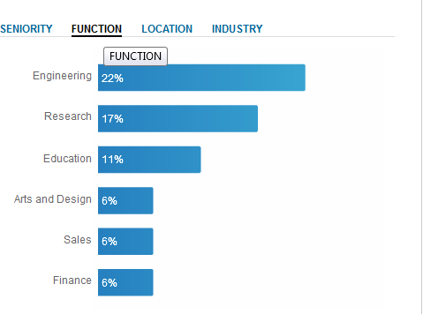
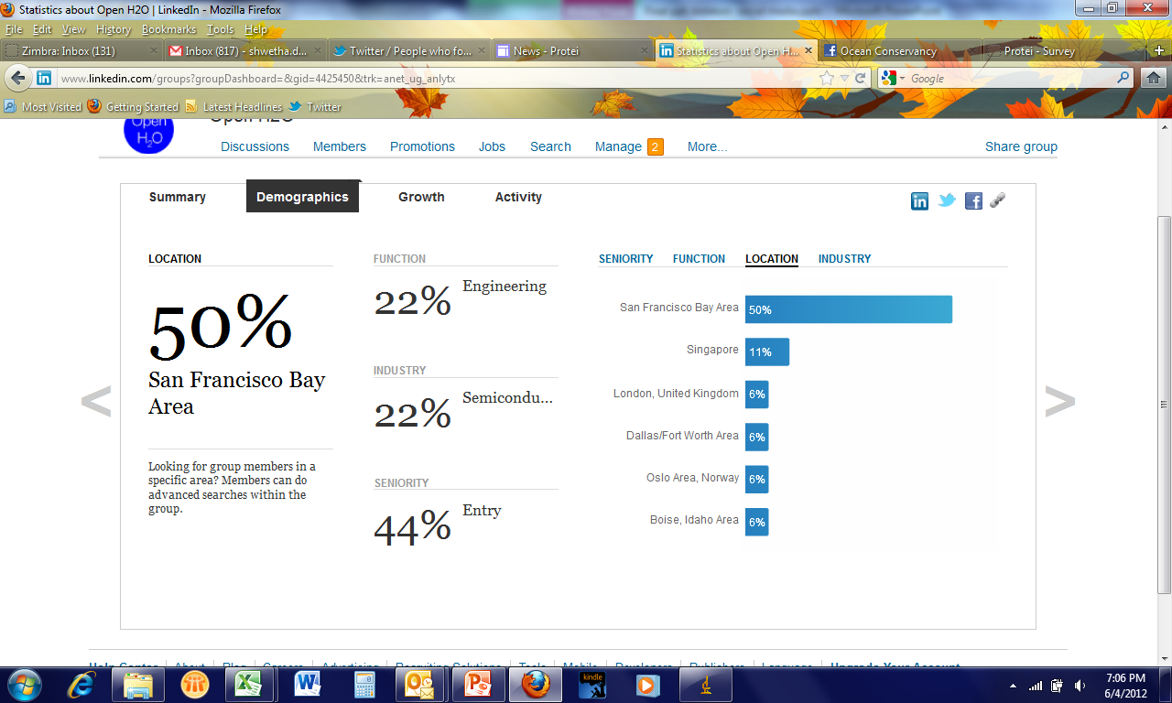
LinkedIn Strategy for OpenH20
DE-DART
OpenH20 group created – May 5th 2012 . Currently has 18 members
OpenH20 company profile created on May 10th 2012
Group Demographics

Slide 57
Potential Technical Collaborators
DE-DART
Notes:
Linkedin is a great platform to find professionals with the expertise required in any field. It can help OpenH20 achieve its short term goal of finding potential technical collaborators to develop Protei. Since it also gives the geographical location of these professionals, it is easier to find the target audience for OpenH20.
There are a total of 25000+ people found on Linkedin who specialize in
Robotics
Automation
Sensors and Actuators
Marine engineering
Mechatronics
In addition, there are also groups for Non-Profits and marketing for NPOs. These groups should bring potential partners for OpenH20.
The industry bigwigs also use Linkedin regularly which makes it important for OpenH20 to create its presence on this site so the interested persons can be converted to potential sponsors.

Slide 58
Experiments and Strategy
DE-DART
Provide access to Team members to post content
Implement Linkedin button on the website
Post surveys on these group boards
Post keywords so people can find OpenH20
Create groups for collaborators with Applications such as “Github” and “Projects and Teamspaces”
How to find collaborators?
Invite people to join group – Creates awareness
  40% of the people invited, joined the group
Post job openings on the group boards
Post promotions and discussions on these group forums
Join Technology Professionals group – can find potential collaborators

Slide 59
Pros and Cons
DE-DART
Networking site | Pros | Cons
 | Bigger user base – increases visibility | User base mostly younger Limited interaction between users Limited space to post content Hard to find industry key people
 | Great to find Industry key people Faster way to connect with people Target audience can find us with #tags Search engine indexed | Limited space available to post content
 | Great to find Industry key people Huge base of technical collaborators available and can filter out with geographic location Search engine indexed and higher page rank on Google Higher interaction between users | No #tags available for people to find us Need to reach out to people individually Limited space to post content

Slide 60
Blogs for OpenH20
DE-DART
Why Improve Blog?
Enhance visibility
Increase traffic for community website
Establish industry expertise
Promote products
Generate leads
Sources:
http://www.forbes.com/sites/kenmakovsky/2012/05/14/why-should-companies-blog/
25% of the survey participants would like to get information about OpenH2O from Blogs
Notes:
Blog created on Wordpress on May 15th 2012. Wordpress allows search engine indexing and provides space that the social networks do not provide to post content.

Slide 61
Study Other Community Blogs
DE-DART
DIY drones – community allows members to post on blogs
Members can comment on blog posts
Blog is integrated with the website
Average of 35 blog posts by members
source: http://diydrones.com/profiles/blog/list

Slide 62
Recommendations for Blog
DE-DART
Recommendations to improve the blog section for Protei/OpenH20, based on study
  Integrate webpage with the website and make navigation easier
  Provide login information to access the blog page to all members of the community
  Allow members to post about industry related events/information
  Need to have comments section to allow people to interact
  Write articles/provide links to articles from industry
  Have industry key people post guest blogs
  Post interviews conducted with industry key people

Slide 63
Website Design
DE-DART
Research Findings
What Users want
Feature responses participants most want to see
Notes:
The most wanted features:
Educational Resources
Open Source Project Instructionals
Uncovering new research

Slide 64
Website Design
DE-DART
Organizing the content
Project Centricity
  The “Project Space”
Forums
Notes:
Why
Webpage no longer a collection of information
If we want to attract users, we must be able to relate to them
Not just that, we must tell our story in the most "frictionless" way possible
What are they looking for most when they come onboard
How does this fit in with our goals
Projects centric
Collaboration platform for project member
Forums for community discussion
Reorganize this page:

Slide 65
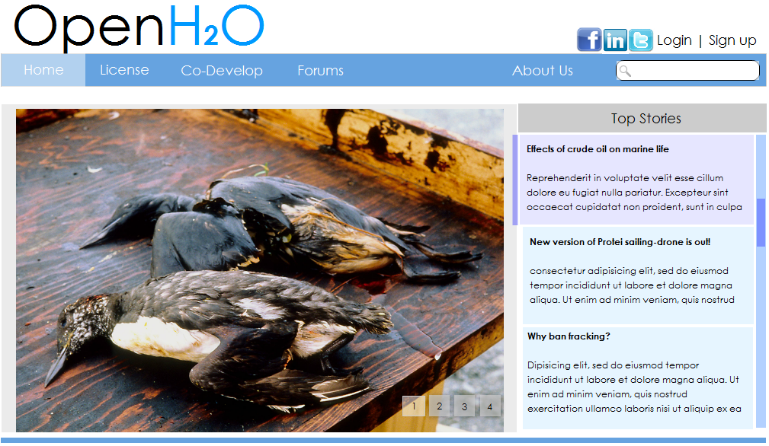
DE-DART
Website Design
Organizing the content
Notes:
What goes here:
News
Research headlines
Product showcase
Key takeaway:
Not all content are created equal.
Develop the back-end capability to 'sense' what people seem to like, and put these articles in front.
Tie this back to our motivations page

Slide 66
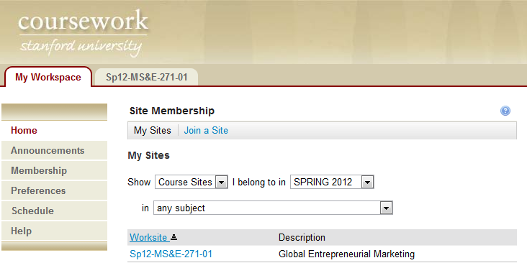
DE-DART
Website Design
Project Centricity
College
Portal
Individual
Student Space
OpenH2O
Project Space
Notes:
Centralized, uniform portal for everyone
Inspiration?
College portals
Institution: OpenH2O
Students: Projects

Slide 67
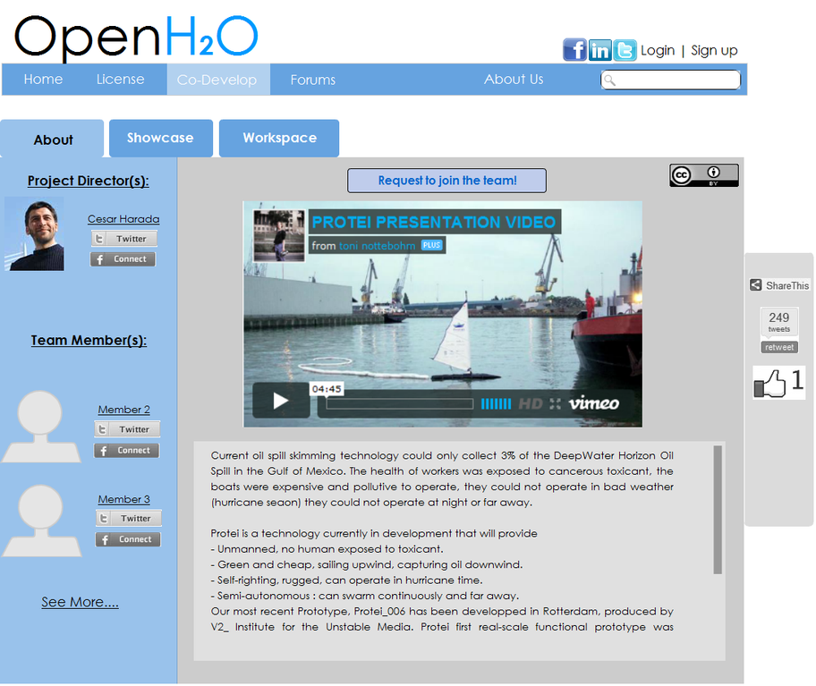
DE-DART
Website Design
Introducing the Project Space
All projects share the same feature set:
About
Showcase
Workspace
Notes:
All projects share the same feature set
About Us:
Showcase:
Workspace:
3 way venn diagram, highlight current section and grey out others
Highlight what I’m talking about
Come up with a better way to title these few slides

Slide 68
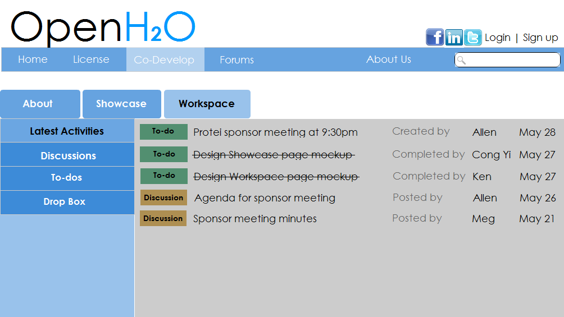
DE-DART
Website Design
Project Centricity: The Workspace
The Workspace:
A set of integrated collaborative tools
Notes:
One-to-many dessemination
Many-to-many sharing

Slide 69
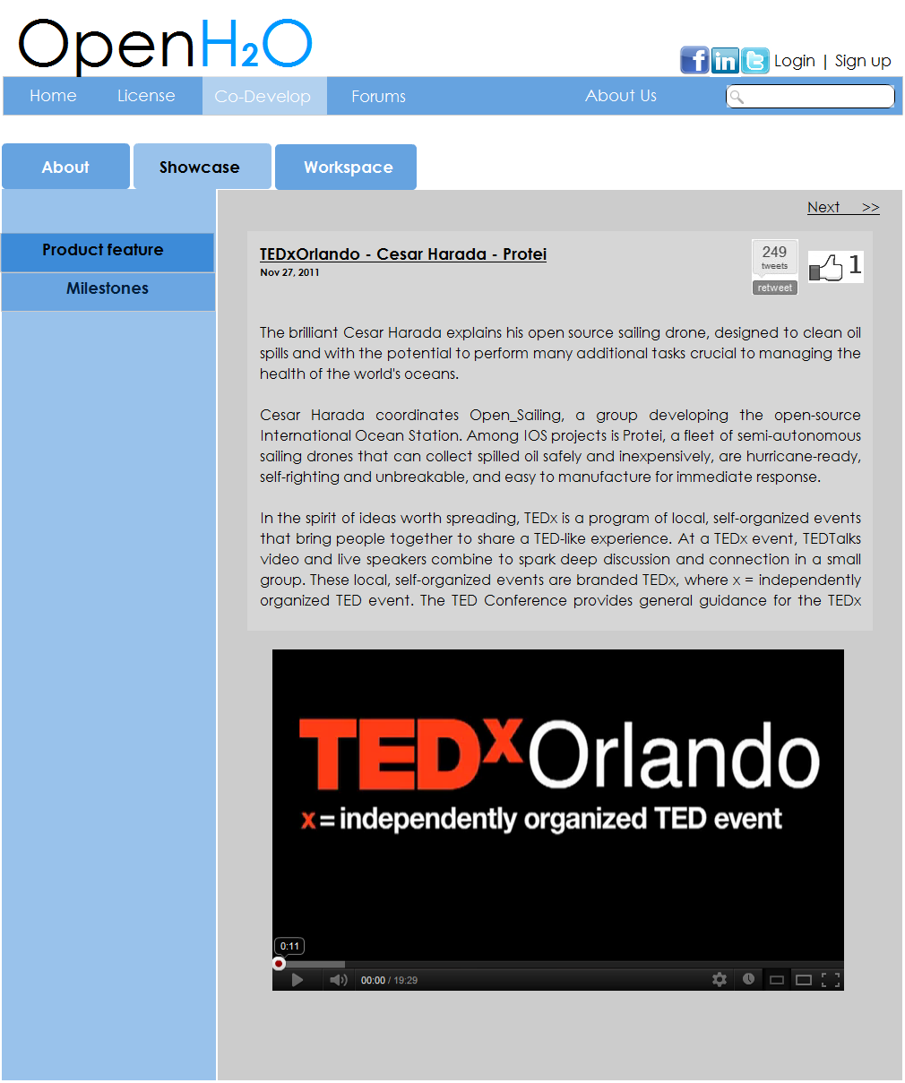
Website Design
DE-DART
Project Centricity: The Showcase Page

Slide 70
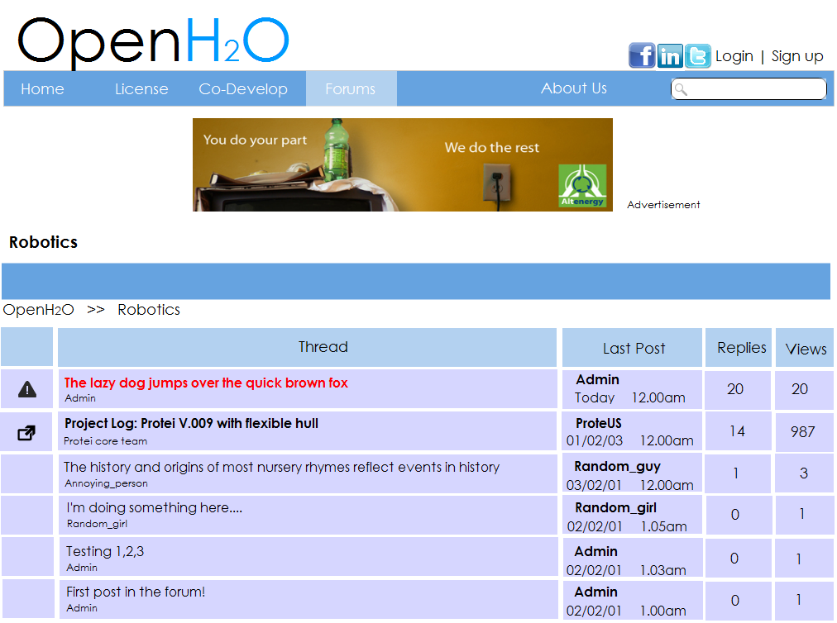
Website Design
DE-DART
Forums
Notes:
Advantages of a message board:
Versatile - Discussions, idle chit-chat, Marketplace
Classic - phpBB, vBulletin follow a similar format and have

Slide 71
Analysis: Partnerships
DE-DART
An Illustrative List
Parnership groups | Examples
University with Ocean Programs | Stanford, University of California (Santa Cruz), California State University
Companies interested in ocean | Show Boats, Odyssey Marine Exploration, Airmar, Bluefin Robotics
Government | Environmental Protection Agency (EPA), National Science Foundation
Open-source communities | instructables.com, diydrones.com
Online ocean sites | oceanforyouth.org, seasky.org
Notes:
Partnerships should be separate within Analysis
List them be specific: universities with ocean programs, santa cruz, other UCs, international universitities, companies interested in ocean (BP, energy companies), government, environmental protection agency, other open source communitites (instructables, DIYdrones), online ocean sites
Specific examples
put in table: category and specific list
Jeff Moores 2x2 Matrix
Do give get for strategic/learning (pick two)
4 slides:
1) illustraive list
2) 2x2 grid
3) give/get
4) give/get

Slide 72
Analysis: Partnerships
DE-DART
$$
Earning Partners
Strategic Partners
Companies
Government
Sponsors
Non Profit Organizations
Open-source communities
Online Ocean Sites
Universities
Limited Partners
Learning Partners
Knowledge
Notes:
Partnerships should be separate within Analysis
List them be specific: universities with ocean programs, santa cruz, other UCs, international universitities, companies interested in ocean (BP, energy companies), government, environmental protection agency, other open source communitites (instructables, DIYdrones), online ocean sites
Specific examples
put in table: category and specific list
Jeff Moores 2x2 Matrix
OpenH20 should focus on learning partners first, then focus on others after (highlight talking points)
Do give get for learning (pick two)
4 slides:
1) illustraive list
2) 2x2 grid
3) give/get
4) give/get

Slide 73
Partnerships: Open Source Communities
DE-DART
Potential stakes to bet on partnership | Partner can give | Partner can get
Assets | Customer base | Traffic back from OpenH2O community
Technology | Information about other cool technologies | Information about innovative projects/events happening on OpenH2O
Resources | Knowledge about how to build a community | New technology resources
Reputation | Credit as cutting edge projects | Featured as innovative technologies on OpenH2O
Core competencies | Increase traffic to OpenH2O | Official support from OpenH2O on technologies
Source: Kosnik (2000), “Managing a Portfolio of Polygamous Partnerships?”
Notes:
Partnerships should be separate within Analysis
List them be specific: universities with ocean programs, santa cruz, other UCs, international universitities, companies interested in ocean (BP, energy companies), government, environmental protection agency, other open source communitites (instructables, DIYdrones), online ocean sites
Specific examples
put in table: category and specific list
Jeff Moores 2x2 Matrix
Do give get for strategic/learning (pick two)
4 slides:
1) illustraive list
2) 2x2 grid
3) give/get
4) give/get

Slide 74
Partnerships: Universities
DE-DART
Potential stakes to bet on partnership | Partner can give | Partner can get
Assets | Customer base | Innovative practical projects for teaching purposes
Technologies | Knowledge from universities' ocean program | Instructors/Instructions, demo sessions for students
Resources | Contributions from students, professors | Real world project for ocean programs
Reputation | Endorsement | Innovative programs with practical and innovative projects
Core competencies | Expose OpenH2O to large students base | Training materials/supports
Source: Kosnik (2000), “Managing a Portfolio of Polygamous Partnerships?”
Notes:
Partnerships should be separate within Analysis
List them be specific: universities with ocean programs, santa cruz, other UCs, international universitities, companies interested in ocean (BP, energy companies), government, environmental protection agency, other open source communitites (instructables, DIYdrones), online ocean sites
Specific examples
put in table: category and specific list
Jeff Moores 2x2 Matrix
Do give get for strategic/learning (pick two)
4 slides:
1) illustraive list
2) 2x2 grid
3) give/get
4) give/get

Slide 75
Timeline for Action Plan
DE-DART
Build up the minimum viable feature set
Prepare launch articles e.g. News to publish, projects to feature
Recruit a core team of people to manage the site
Organize events
Start promoting OpenH2O via partners and channels
Showcase OpenH2O to the world!
Go on TED X
Approach corporate sponsors/VCs with the numbers!
Phase 1
Phase 2
Phase 3
Website goes live
Critical Mass reached
Notes:
Phase 1, 2, 3

Slide 76
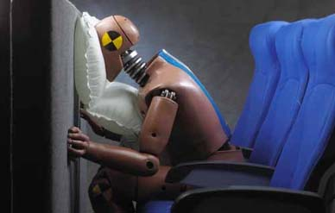
Reality Test
DE-DART
Bracing for impact
Mitigation and contingency strategy

Slide 77
Reality Test
DE-DART
Risk | Mitigation Strategy | Contingency Strategy
OpenH2O's website does not gain traction | Find out which features are attractive/ off-putting and work on them | Incentivize partners/channels to promote OpenH2O
Few projects come onto OpenH2O | Approach high-schools/colleges and offer to feature their projects on the site | Re-think the collaborative tools offered on OpenH2O and see if it is lacking in depth or scope
Not enough resources to handle sudden growth | Engage community to volunteer pro bono | Seek individual donors or corporate sponsors sooner to fund team
Source: MS&E 271
Notes:
Seek advice from web-devs and users.
Do the criticisms agree with one another?
Incentivizing parters:
Who would benefit from OpenH2O's success?
Donation ala wikipedia

Slide 78
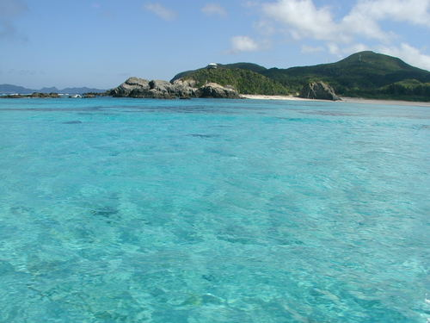
Last Thoughts
“Give a person a fish and he will eat for a day,
Teach a person how to fish and he will eat for a lifetime”

Slide 79

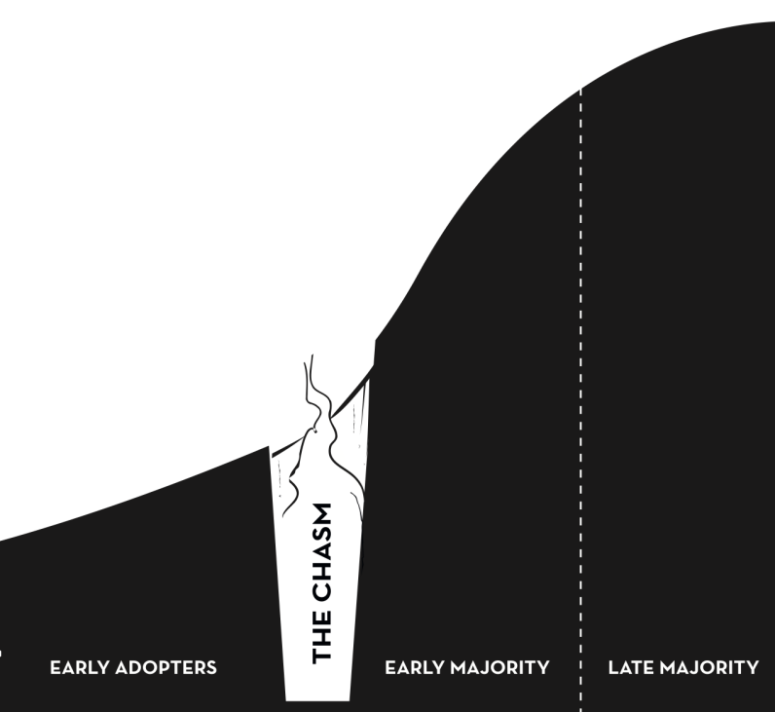
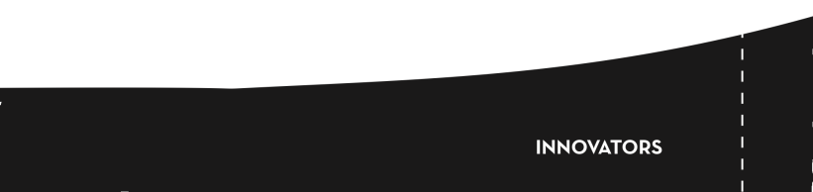
Last Thoughts
OpenH2O in the future
Protei in the present
TOP
Notes:
This is where we started, with Protei
We wish to get OpenH20 here and the DE-DART framework, recommendations, analysis, will provide the right fuel to drive OpenH20 across the chasm

Slide 80
Thank You
Hope to see you guys soon :)

Slide 81
Appendix

Slide 82
Connect Rather Than Convince
Notes:
Put this in appendix

